Slide 1

Handling Big Data -Airlines dataset-
Chiorean Bogdan-Alin

Slide 2
Table of contents
1
Project overview
2
Big data challenges
3
4
Results
Design & implementation
5
Future work & conclusions

Slide 3
1
Project overview

Slide 4
Project overview
Project goal
Showcasing big data handling on a large dataset
Compute and analyze some big data tasks, such as:
Statistical analysis (ANOVA)
ML tasks (Linear regression)
Time-series analysis (Seasonal analysis)

Slide 5
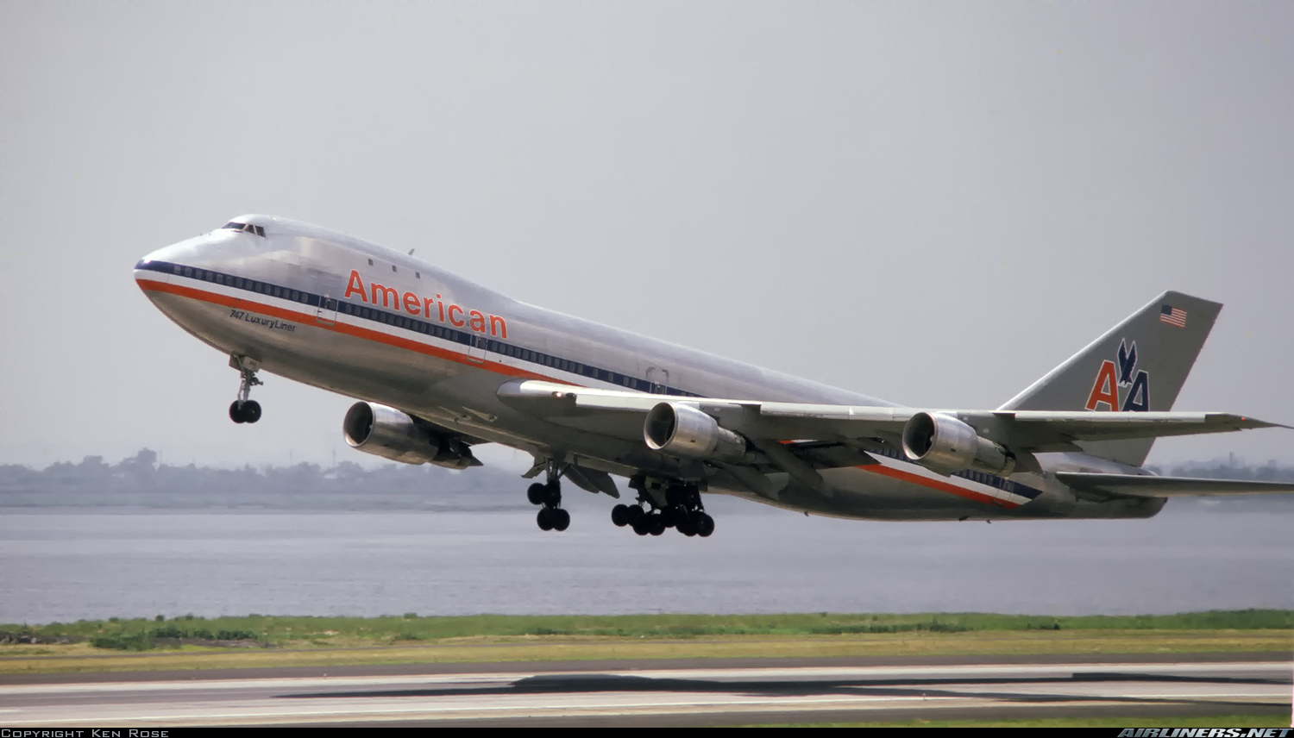
Project overview
About our dataset
Flight arrival and departure details for all commercial flights within the USA, from October 1987 to April 2008
Total number of records: 120M
Compressed dataset: 1.6GB
Uncompressed dataset: 12GB

Slide 6
2
Big data challenges

Slide 7
Big data challenges
Handling big data presents numerous challenges, such as:
Handling the size of the dataset (120M rows)
Running the entire processing workflow (reading and computing large-scale tasks) can overwhelm local memory, leading to bottlenecks
Memory and performance optimizations
Without proper memory management, the processing steps can result in memory errors and inefficiencies

Slide 8
Big data challenges
Transition to a cloud infrastructure
Moving from local computation to cloud infrastructure requires adapting workflows and addressing compatibility issues between local tools and cloud tools
Data quality and null values
Data quality, especially numerous null values in the provided dataset can distort analysis and model predictions
Each challenge will be addressed in the following chapter

Slide 9
3
Design & implementation

Slide 10
Design & implementation
Workflow
Taking into consideration the previously mentioned challenges, our workflow looks like this:
Data preprocessing: using Pandas and Dask
Data loading: using Azure Storage
Data processing: using Azure Databricks

Slide 11
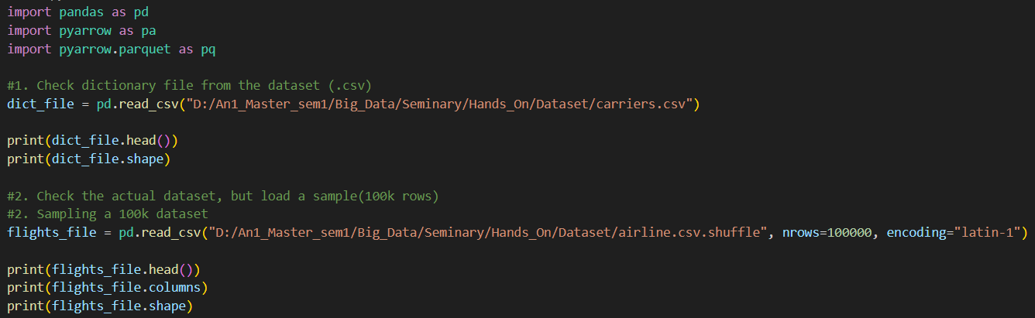
Design & implementation
1. Data preprocessing
This step takes place locally, and consists of:
Data familiarization: explore the contained columns, as well as the initial data

Slide 12
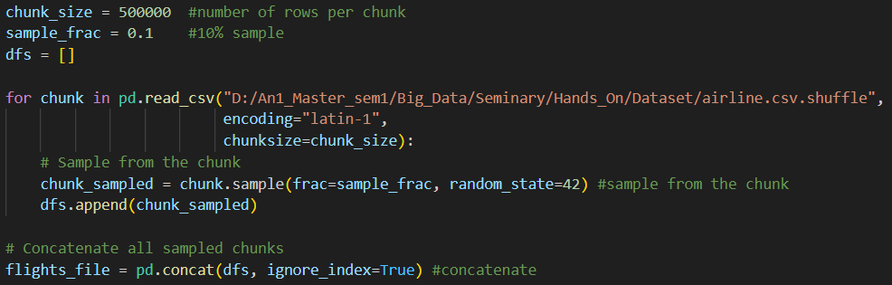
Design & implementation
1. Data preprocessing
This step takes place locally, and consists of:
Data sampling: test and optimize preprocessing, as well as the processing part with different samples

Slide 13

Design & implementation
1. Data preprocessing
This step takes place locally, and consists of:
Data sampling:
for small samples (100k and 10% of the big dataset – 12M rows), we use Pandas functions
for samples that exceed 20% of the initial dataset, we run into memory problems

Slide 14

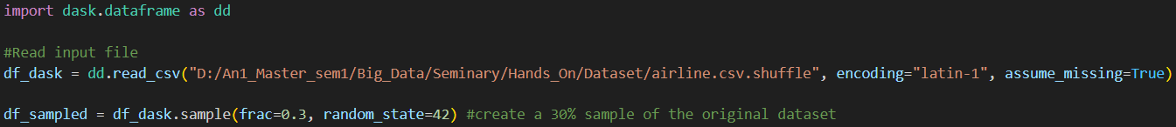
Design & implementation
1. Data preprocessing
This step takes place locally, and consists of:
Data sampling: for bigger samples (30% - 36M rows, and full dataset), we use Dask
open-source parallel computing library in Python that is designed for Big Data processing

Slide 15
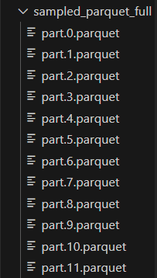
Design & implementation
1. Data preprocessing
This step takes place locally, and consists of:
Data sampling: for our full dataset setup, we partition the data into multiple files

Slide 16

Design & implementation
1. Data preprocessing
This step takes place locally, and consists of:
Data sampling: at the end of every sample creation, we save the generated files in .parquet format
a columnar data format, designed for efficient storage and processing of large datasets

Slide 17

Design & implementation
2. Data loading
Once our samples are generated, we load them into the Azure service, Azure Storage:
What is Azure?
a cloud computing platform and service provided by Microsoft, which offers a wide range of tools and services
Motivation:
Previous experience: Databases project
Variety of tools, including tools for Big Data
Student subscription: granted access to Azure (100$ subscription)

Slide 18
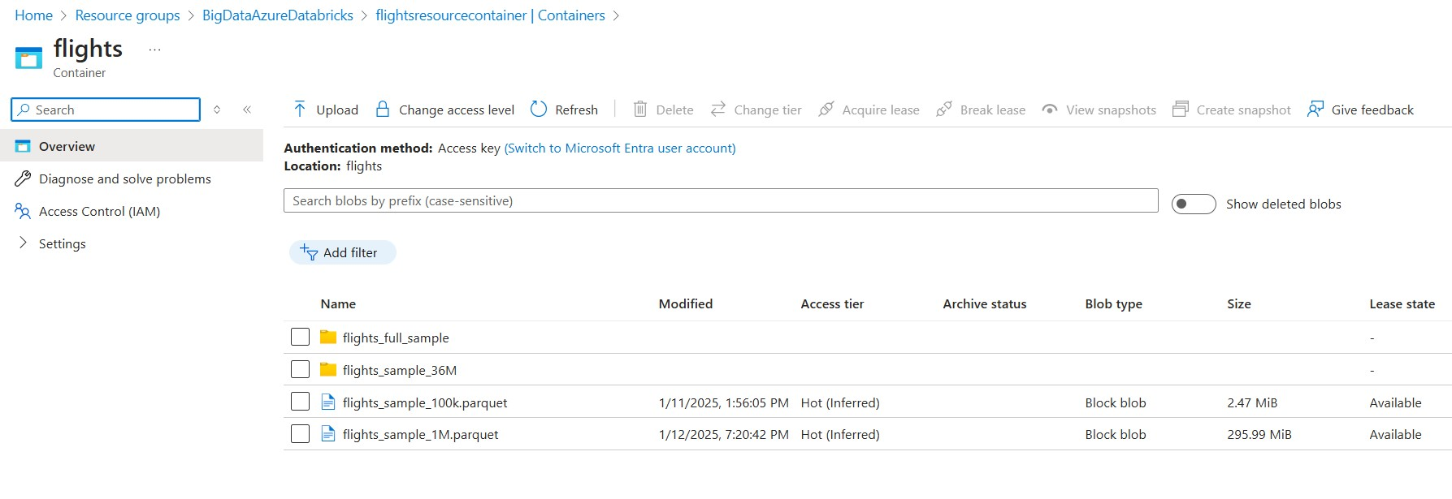
Design & implementation
2. Data loading
Our data container inside Azure looks like this:

Slide 19

Design & implementation
3. Data processing
For our processing part of the workflow, we used Azure Databricks
What is Azure Databricks?
a Big Data analytics and machine learning platform, built on Apache Spark, and seamlessly integrated with Microsoft Azure
Motivation
efficient Big Data processing, with seamless Azure integration
pride: Ion Stoica, Matei Zaharia – romanian founders

Slide 20
Design & implementation
3. Data processing
Data integration into Azure Databricks is pretty simple:
create an Azure Databricks resource inside Azure Portal
launch Databricks from Azure Portal
inside Databricks, configure a cluster (for our case, and our subscription limits, a single-node cluster)
create a new notebook and attach the created cluster to it

Slide 21
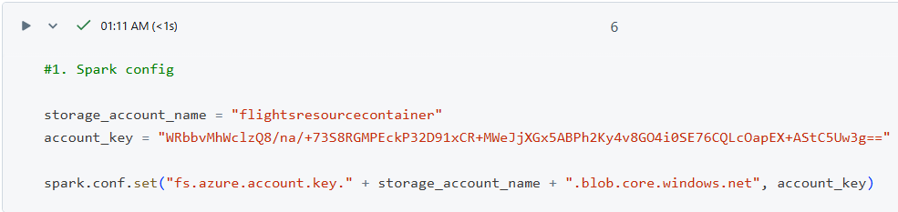
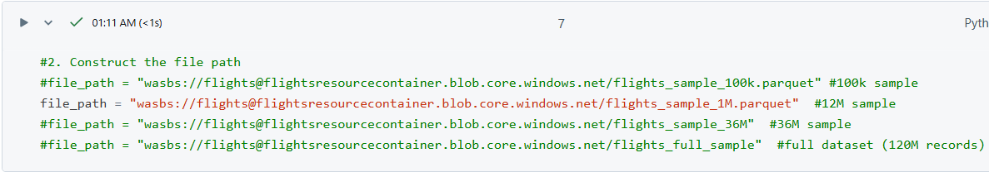
Design & implementation
3. Data processing
Data integration into Azure Databricks is pretty simple:
configure the path to where our data is stored:

Slide 22
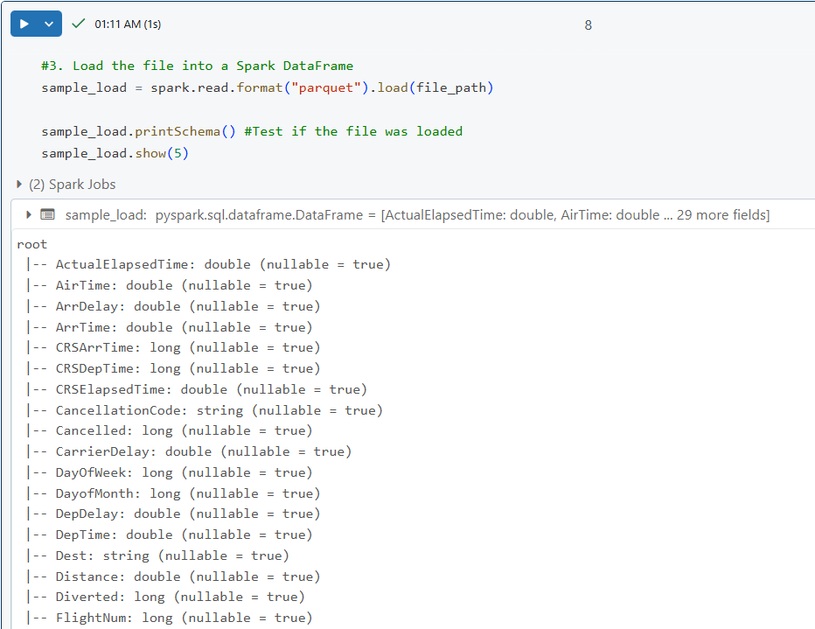
Design & implementation
3. Data processing
Data integration into Azure Databricks is pretty simple:
configure the path to where our data is stored:

Slide 23
Design & implementation
Big Data tasks
As mentioned in the beginning, we will evaluate these Big Data tasks:
Statistical analysis (ANOVA)
ML tasks (Linear regression)
Time-series analysis (Seasonal analysis)
Our analysis focuses on flight delays, identifying the key factors that contribute to delays, and determining which days or months are most prone to experiencing moderate to severe delays

Slide 24
Design & implementation
1. Statistical analysis (ANOVA)
ANOVA (Analysis of Variance)
a statistical tool to determine whether there were significant differences in flight delays (e.g., “ArrDelay”) across various categorical groups such as months or days of the week
Based on the coefficient P:
If P < 0.05: Reject the null hypothesis, indicating that at least one group mean is significantly different
If P > 0.05: Fail to reject the null hypothesis, meaning there’s no strong evidence that group means differ

Slide 25
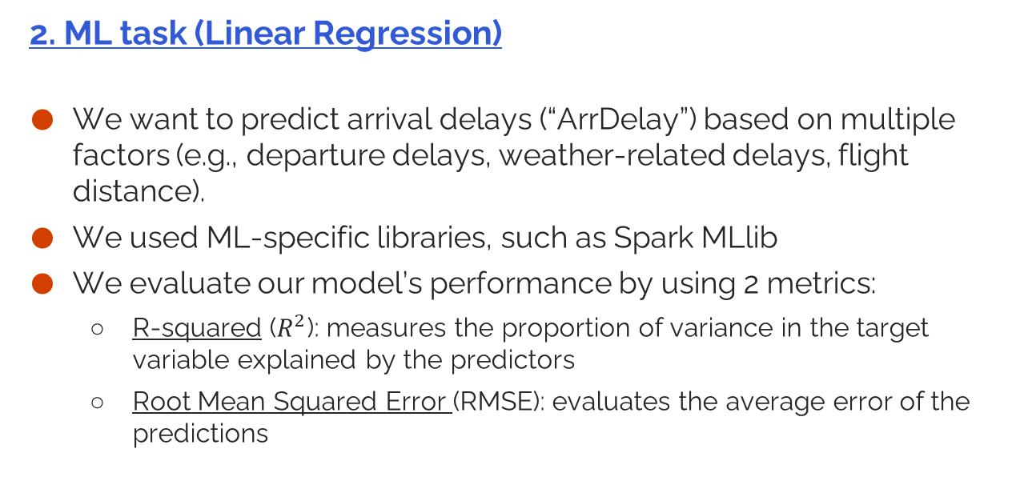
Design & implementation
2. ML task (Linear Regression)
We want to predict arrival delays (“ArrDelay”) based on multiple factors (e.g., departure delays, weather-related delays, flight distance).
We used ML-specific libraries, such as Spark MLlib
We evaluate our model’s performance by using 2 metrics:
R-squared ($R^{2}$): measures the proportion of variance in the target variable explained by the predictors
Root Mean Squared Error (RMSE): evaluates the average error of the predictions

Slide 26
Design & implementation
3. Time-series analysis (Seasonal analysis)
We want to uncover time-based patterns in flight delays (e.g., monthly or weekly variations).
We also want to highlight seasonal spikes, by using:
Monthly trends
Day-of-week analysis
Based on the plotted graphs, we will output the conclusions

Slide 27
4
Results

Slide 28
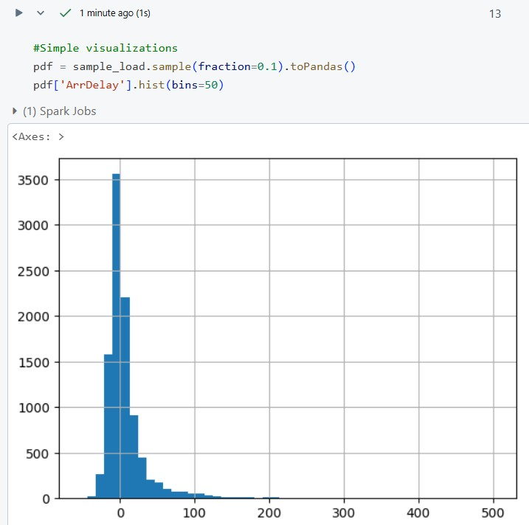
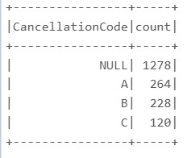
Results
1. Small sample (100k rows)
Cancellation codes
Arrival delay histogram

Slide 29
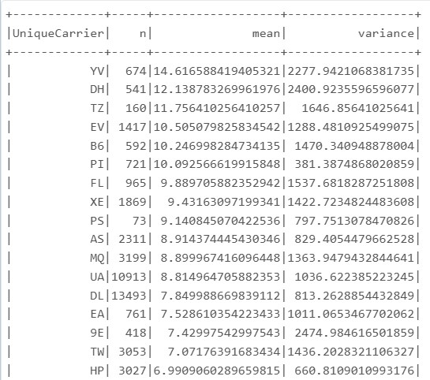
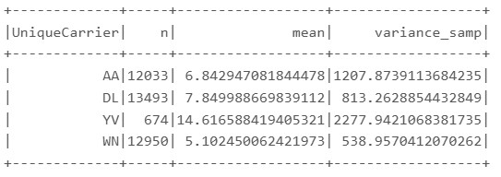
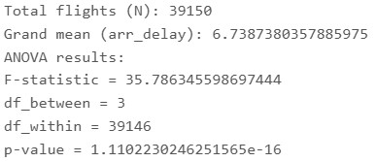
Results
1. Small sample (100k rows)
4 selected carriers values
ANOVA mean-variance
ANOVA results

Slide 30
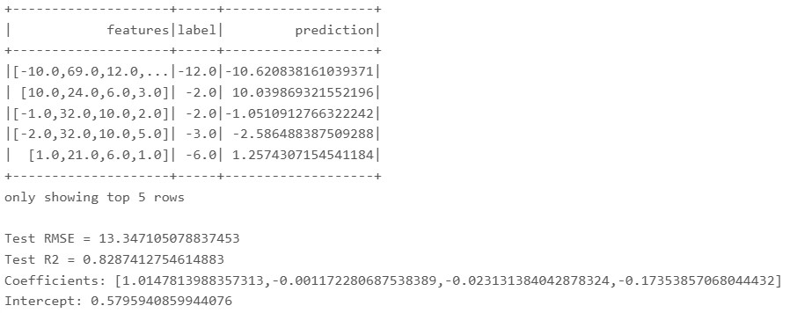
Results
1. Small sample (100k rows)
Linear regression results

Slide 31
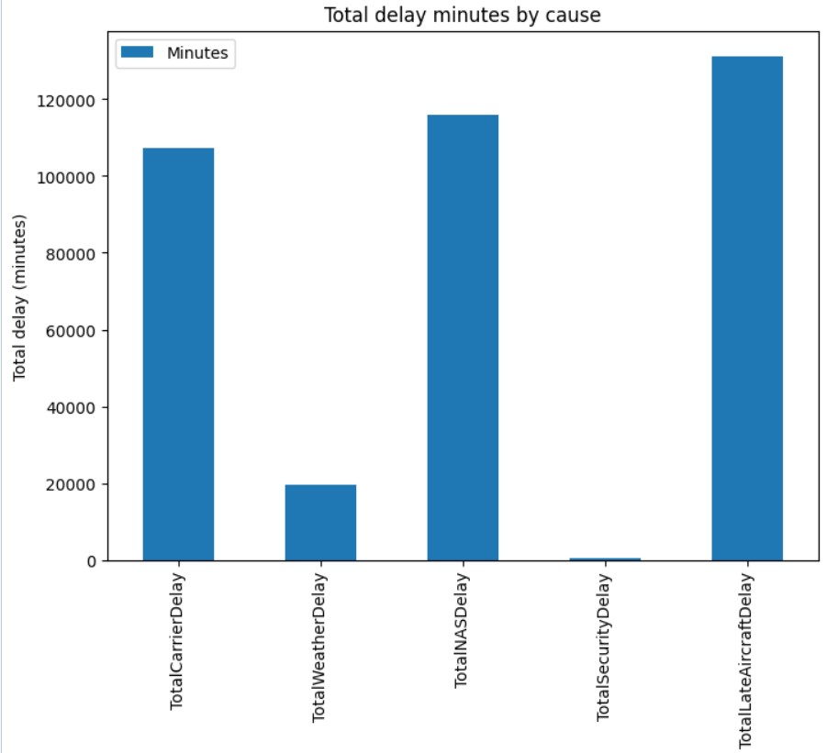
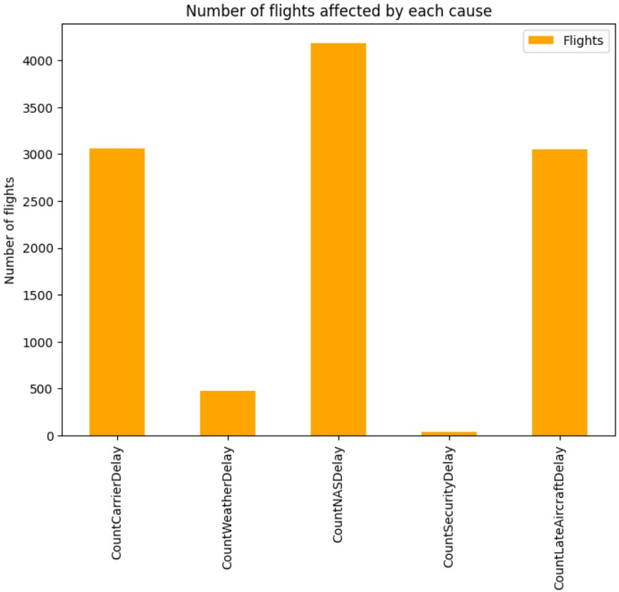
Results
1. Small sample (100k rows)
Seasonal Analysis

Slide 32
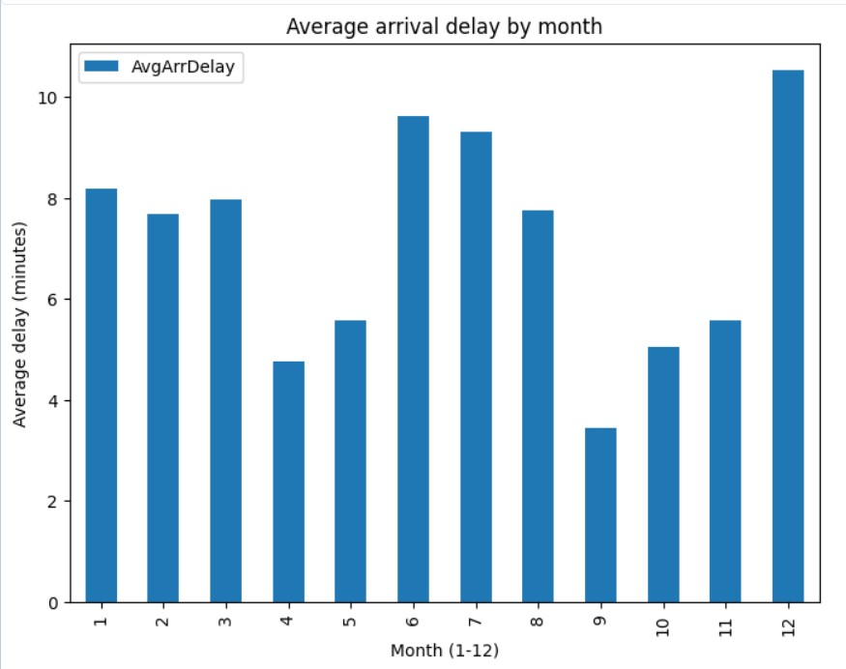
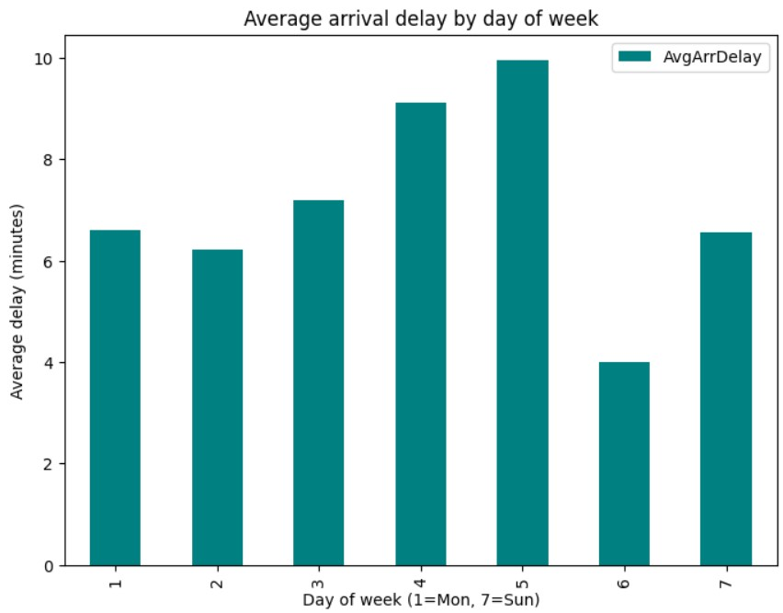
Results
1. Small sample (100k rows)
Seasonal Analysis

Slide 33
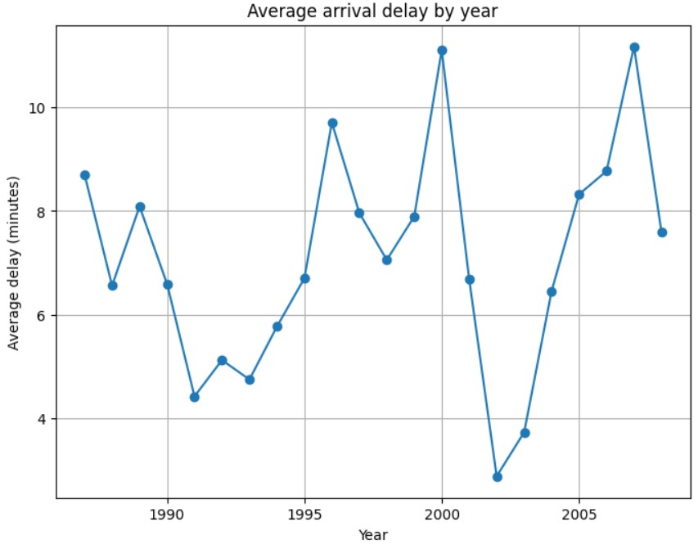
Results
1. Small sample (100k rows)
Seasonal Analysis

Slide 34
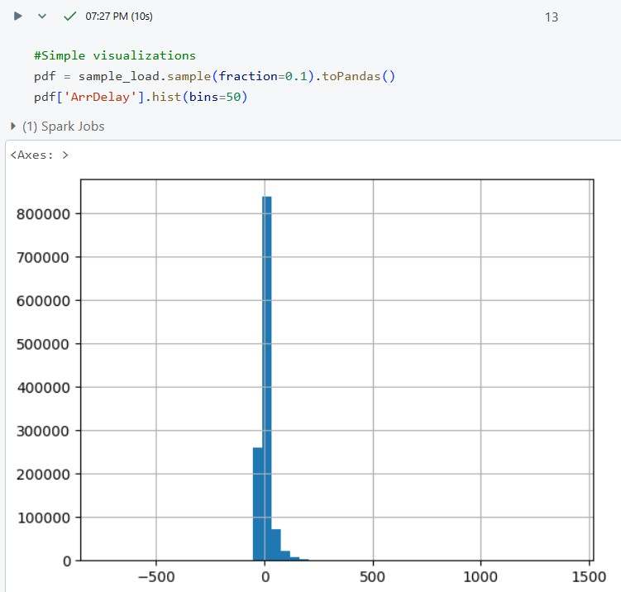
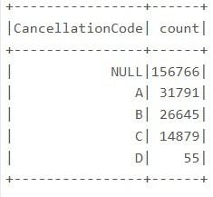
Results
2. Second sample (12M rows)
Cancellation code
Arrival delay histogram

Slide 35
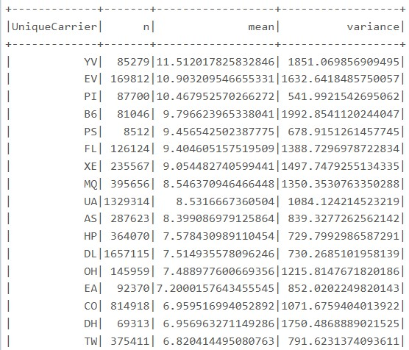
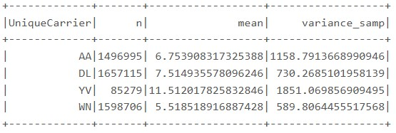
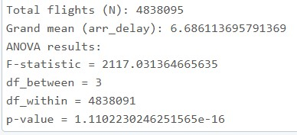
Results
2. Second sample (12M rows)
4 selected carriers values
ANOVA mean-variance
ANOVA results

Slide 36
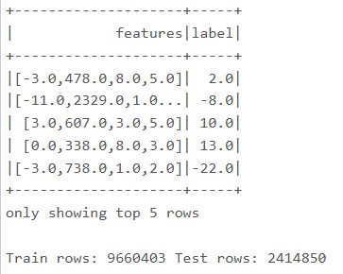
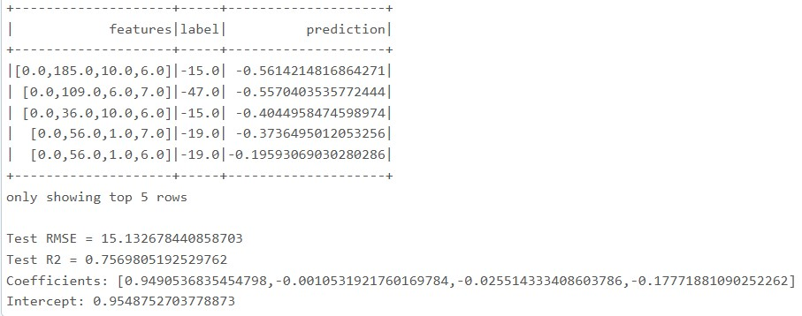
Results
2. Second sample (12M rows)
Linear regression train
Linear regression results

Slide 37
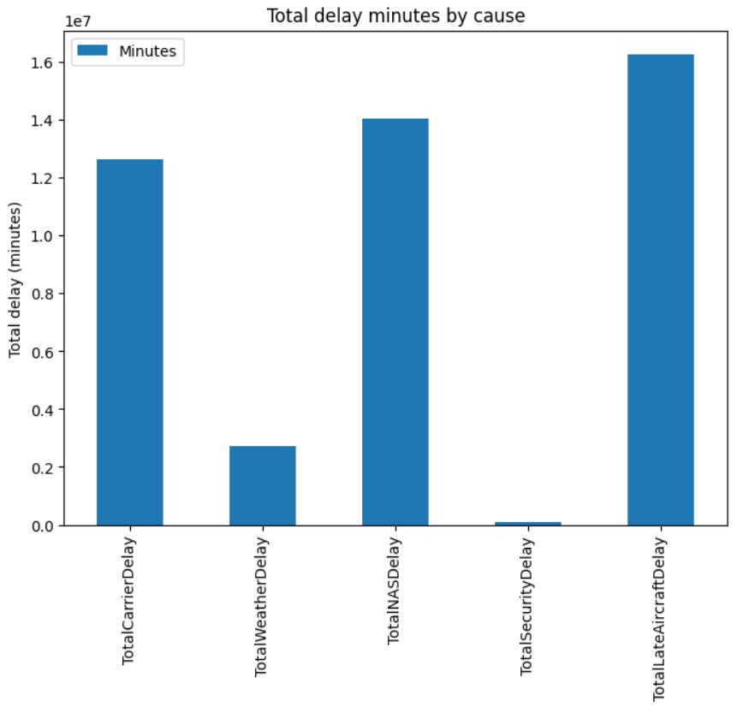
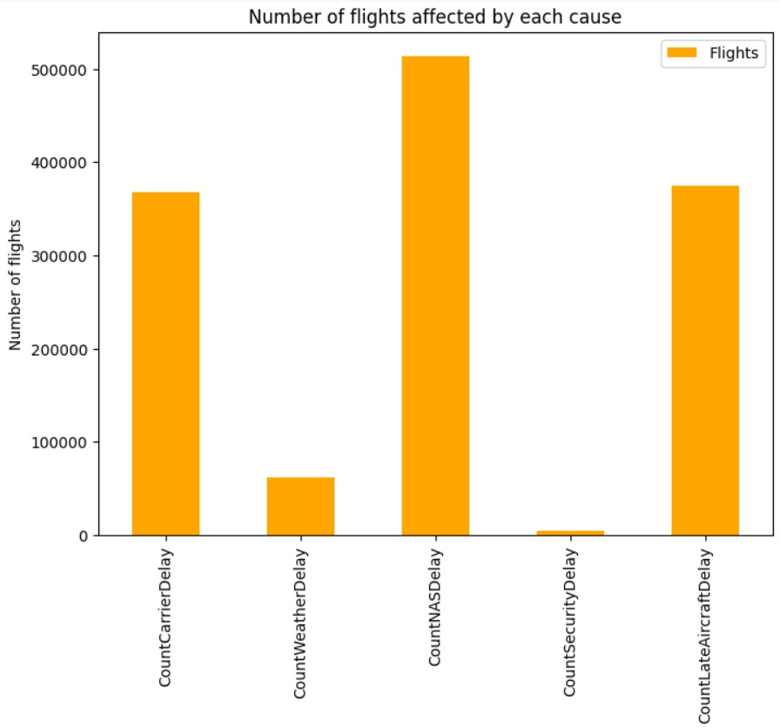
Results
2. Second sample (12M rows)
Seasonal Analysis

Slide 38
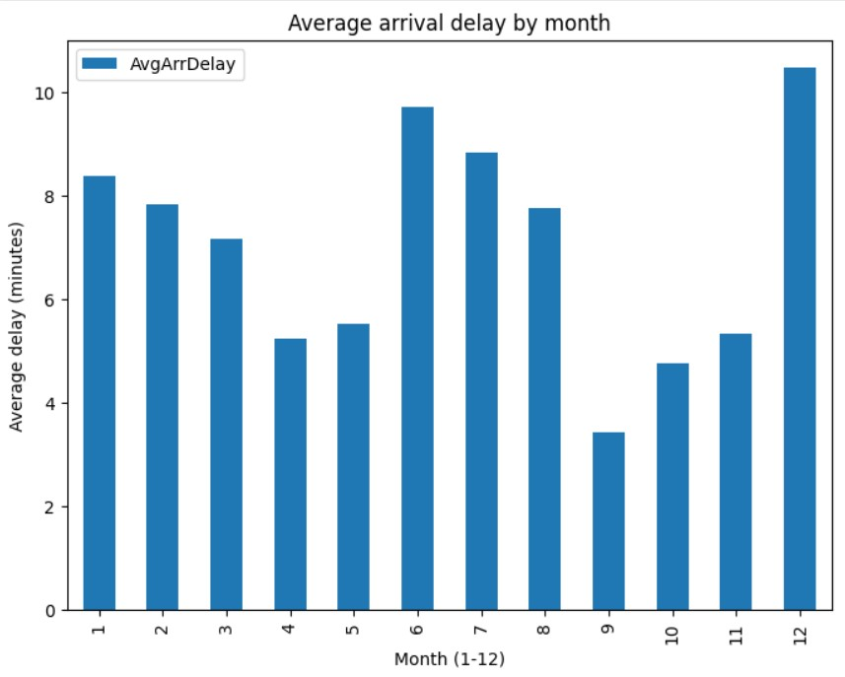
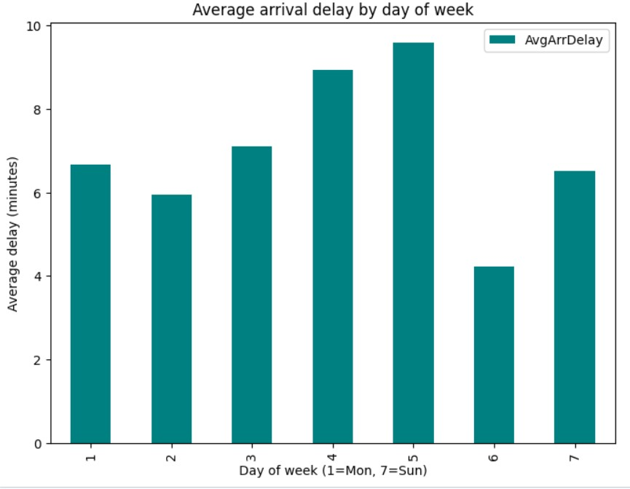
Results
2. Second sample (12M rows)
Seasonal Analysis

Slide 39
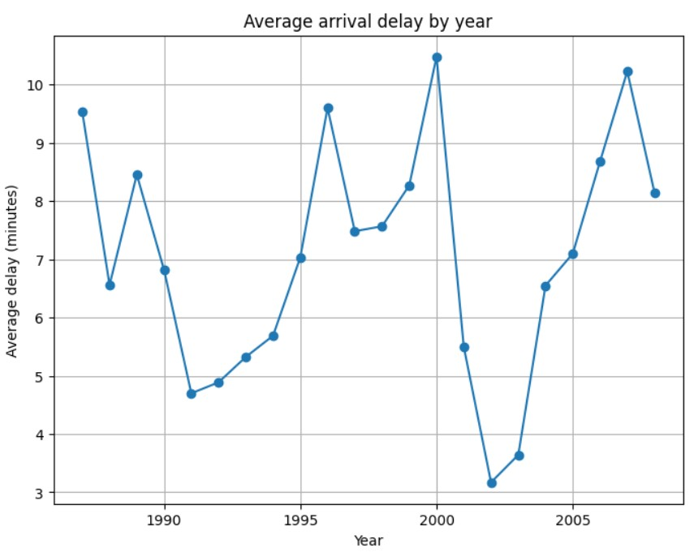
Results
2. Second sample (12M rows)
Seasonal Analysis

Slide 40
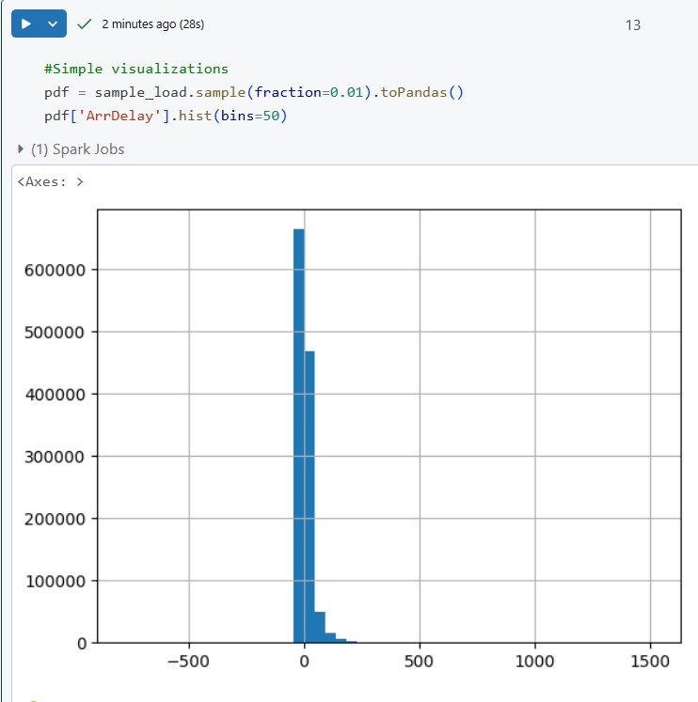
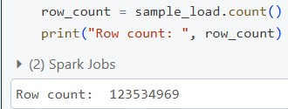
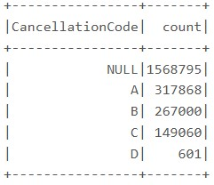
Results
3. Full dataset (120M rows)
Row count
Arrival delay histogram
Cancellation code

Slide 41
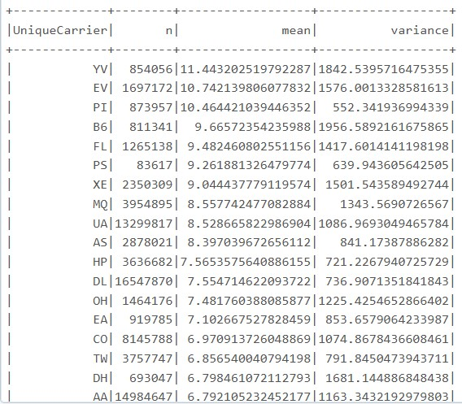
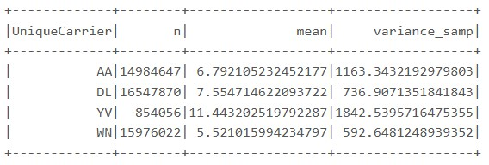
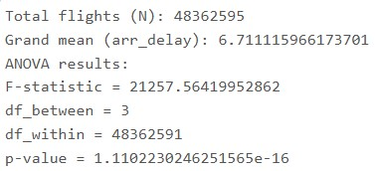
Results
3. Full dataset (120M rows)
4 selected carriers stats
ANOVA mean-variance
ANOVA results

Slide 42
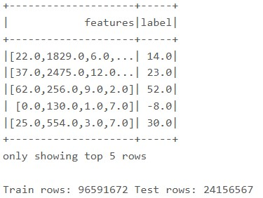
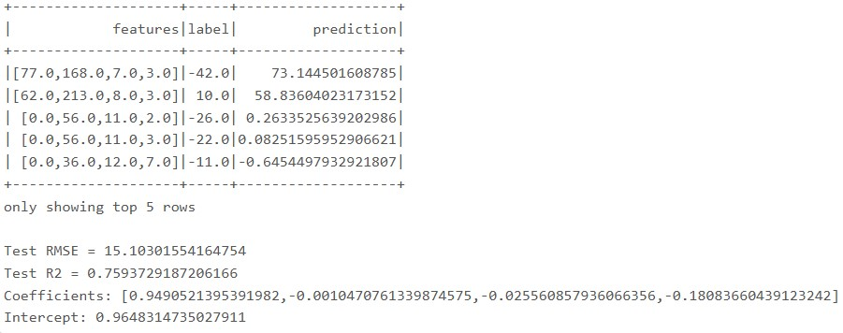
Results
3. Full dataset (120M rows)
Linear regression train
Linear regression results

Slide 43
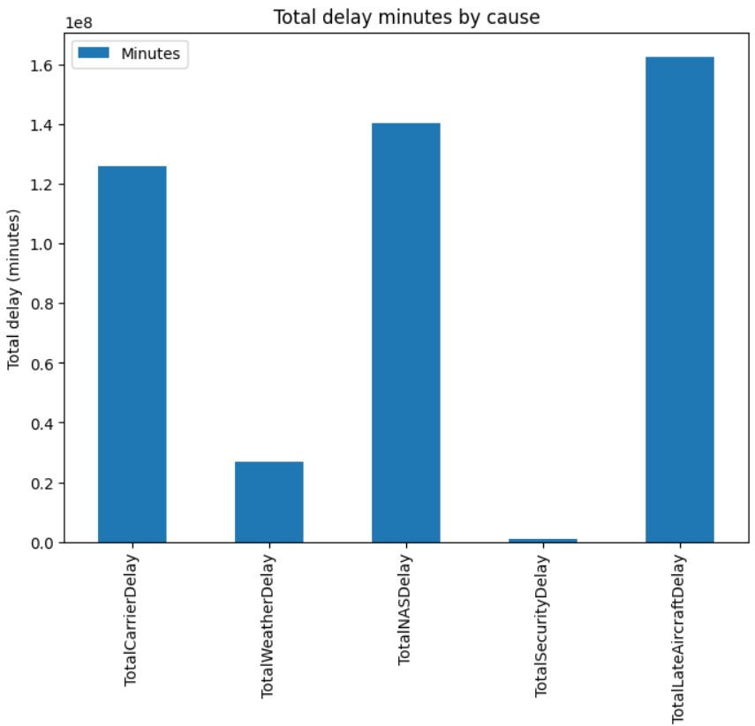
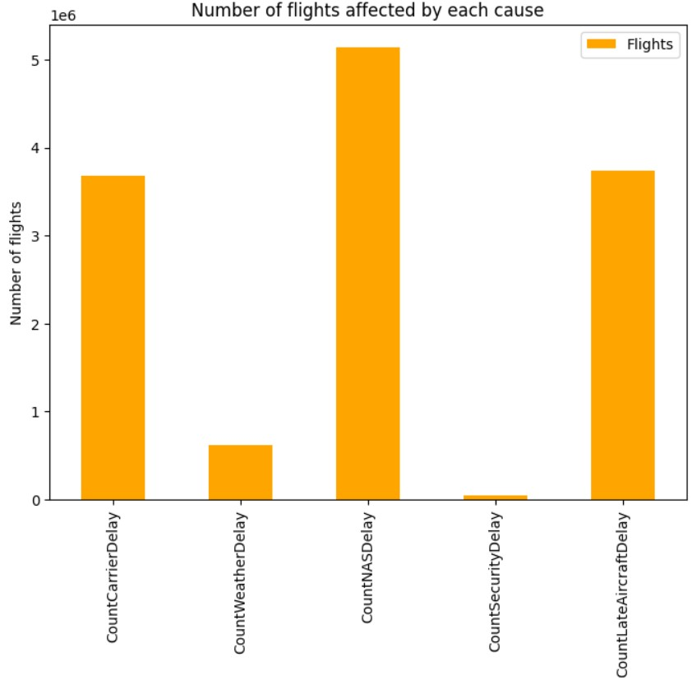
Results
3. Full dataset (120M rows)
Seasonal analysis

Slide 44
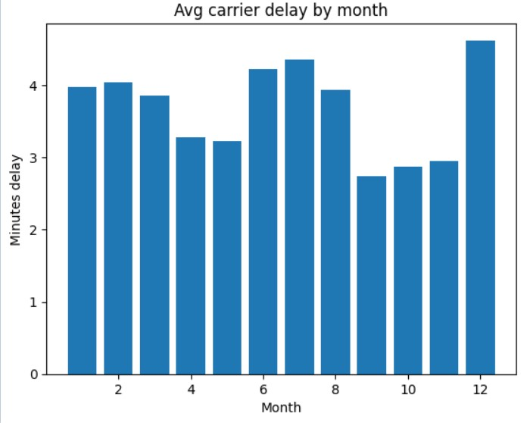
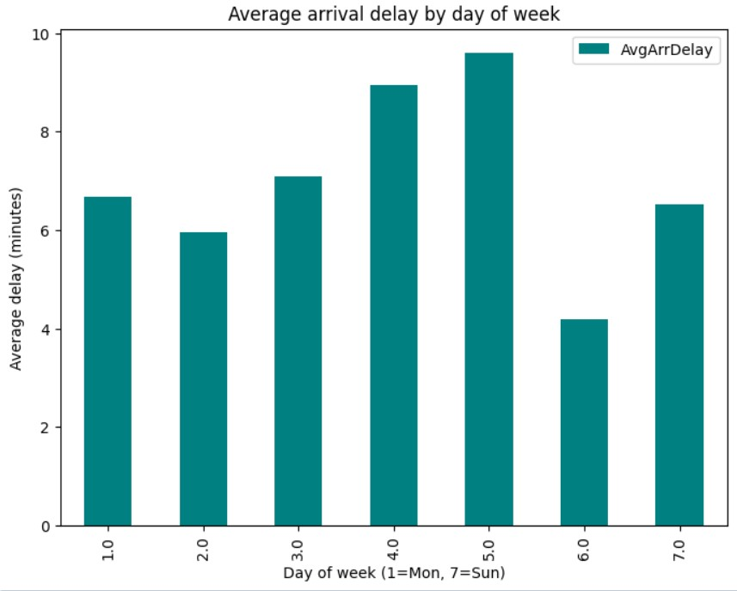
Results
3. Full dataset (120M rows)
Seasonal analysis

Slide 45
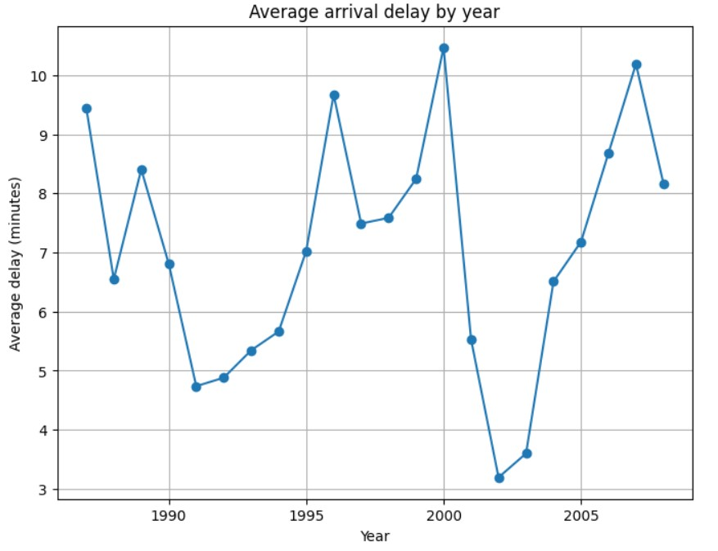
Results
3. Full dataset (120M rows)
Seasonal analysis

Slide 46
5
Conclusions & Future work

Slide 47
Conclusions & Future work
We showcased how to handle big datasets using Azure Storage and Azure Databricks
Future work
Better checking of missing values or better handling of anomalies in our dataset
Explore execution times with different cluster (we tested on a single-node cluster)
Further explore the dataset (in our presentation we’ve only explored delays)
Think of other memory-efficient strategies to handle big datasets

Slide 48
Thanks!
Do you have any questions?
addyouremail@freepik.com
+91 620 421 838
yourwebsite.com
Please keep this slide for attribution

